Slide 1

Joint Species Distribution Models and
Metacommunities
MLU Block Course
Modelling Species Distribution and Biodiversity Patterns Part II
January 12, 2022
Dr. Kimberly Thompson

Slide 2
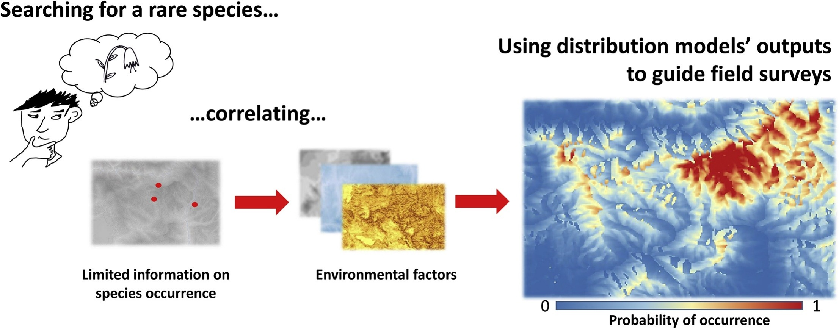
Fois et al. 2018

Slide 3
Many different types of SDMs
Boosted Regression Trees
Multivariate Adaptive Regression Spline
Generalized Linear Models (GLM)
GAM with spatial structure
MaxEnt
Generalized Additive Models (GAM)
Gradient Nearest Neighbor
Support Vector Machines
GLM with spatial random effect
Gradient Extreme Boosting
Random Forest
Multivariate Regression Tree
Norberg et al. 2019

Slide 4
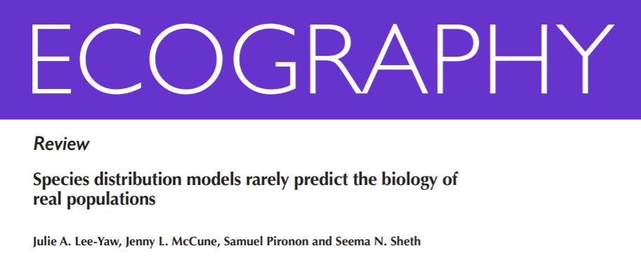
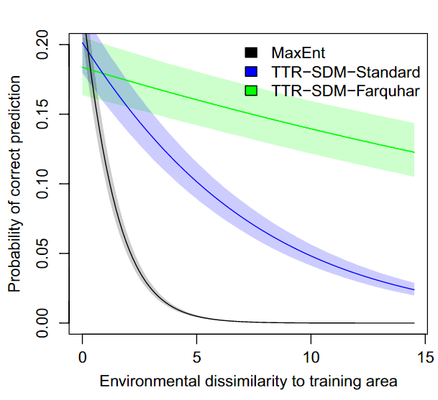
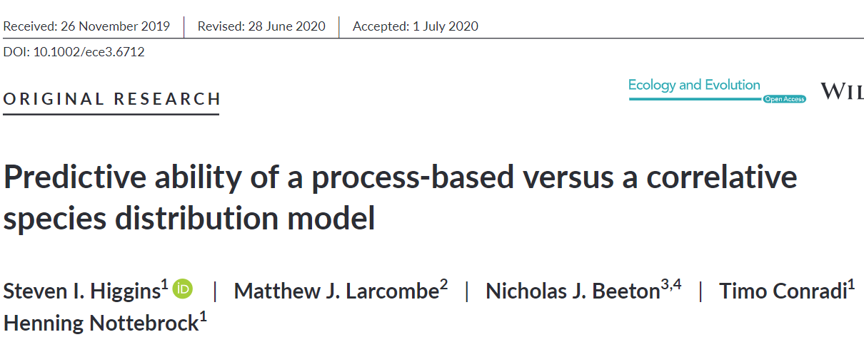
2021

Slide 5
Metacommunity Theory: explains how networks of local communities result from the interplay of stochastic (e.g. demographic stochasticity) and deterministic (e.g. niche differentiation, competition, dispersal) processes at different spatial scales
Joint Species Distribution Models (JSDMs)
Generalized Joint Attribute Modelling
Multivariate Stochastic Neural Networks
Species Archetype Models
Hierarchical Modelling of Species Communities
Leibold & Chase 2017

Slide 6

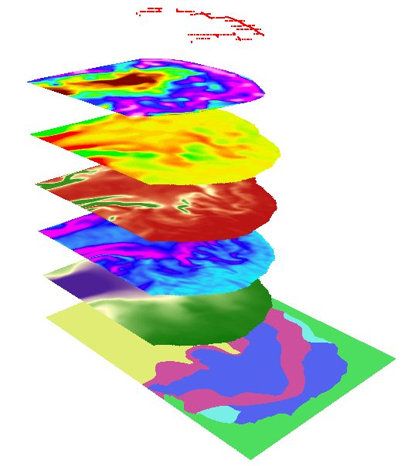
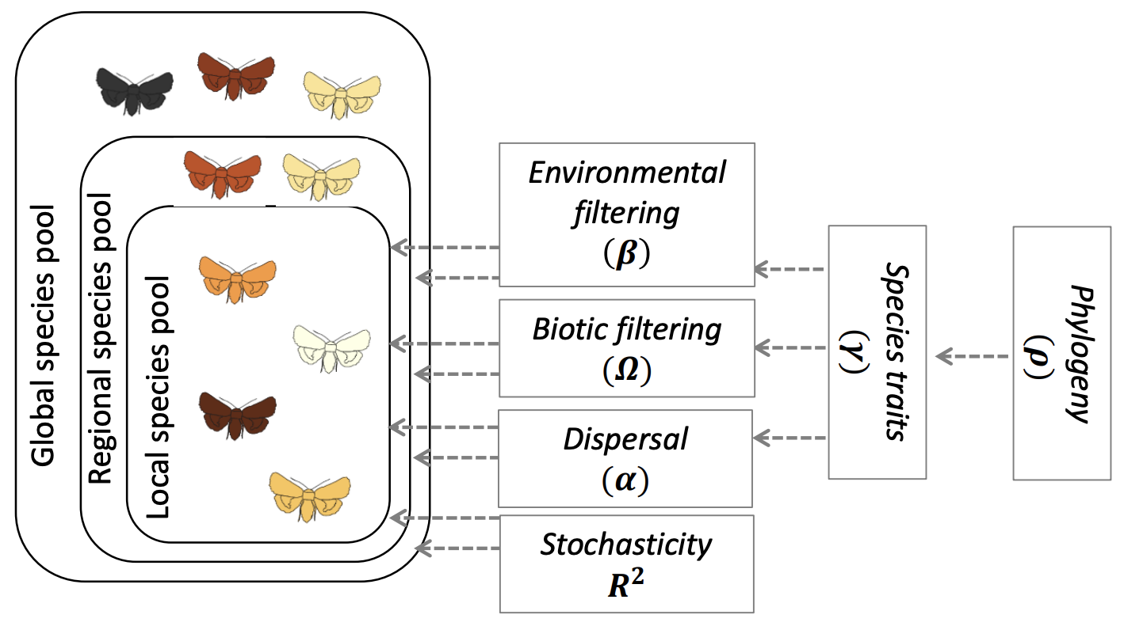
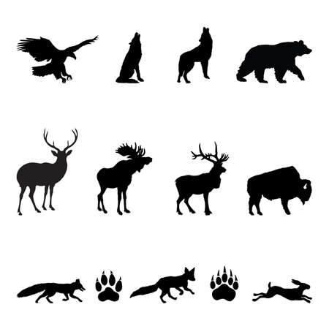
Stacked SDMs vs. Joint SDMs

Slide 7
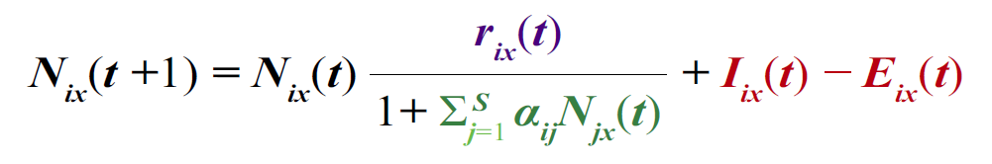
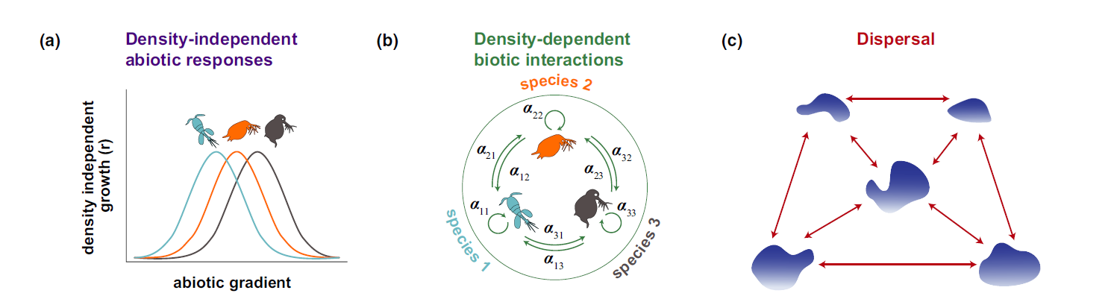

Slide 8
Joint SDMs
Ovaskainen et al. 2017

Slide 9
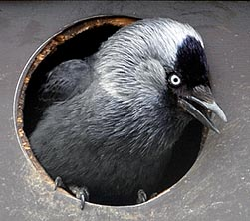
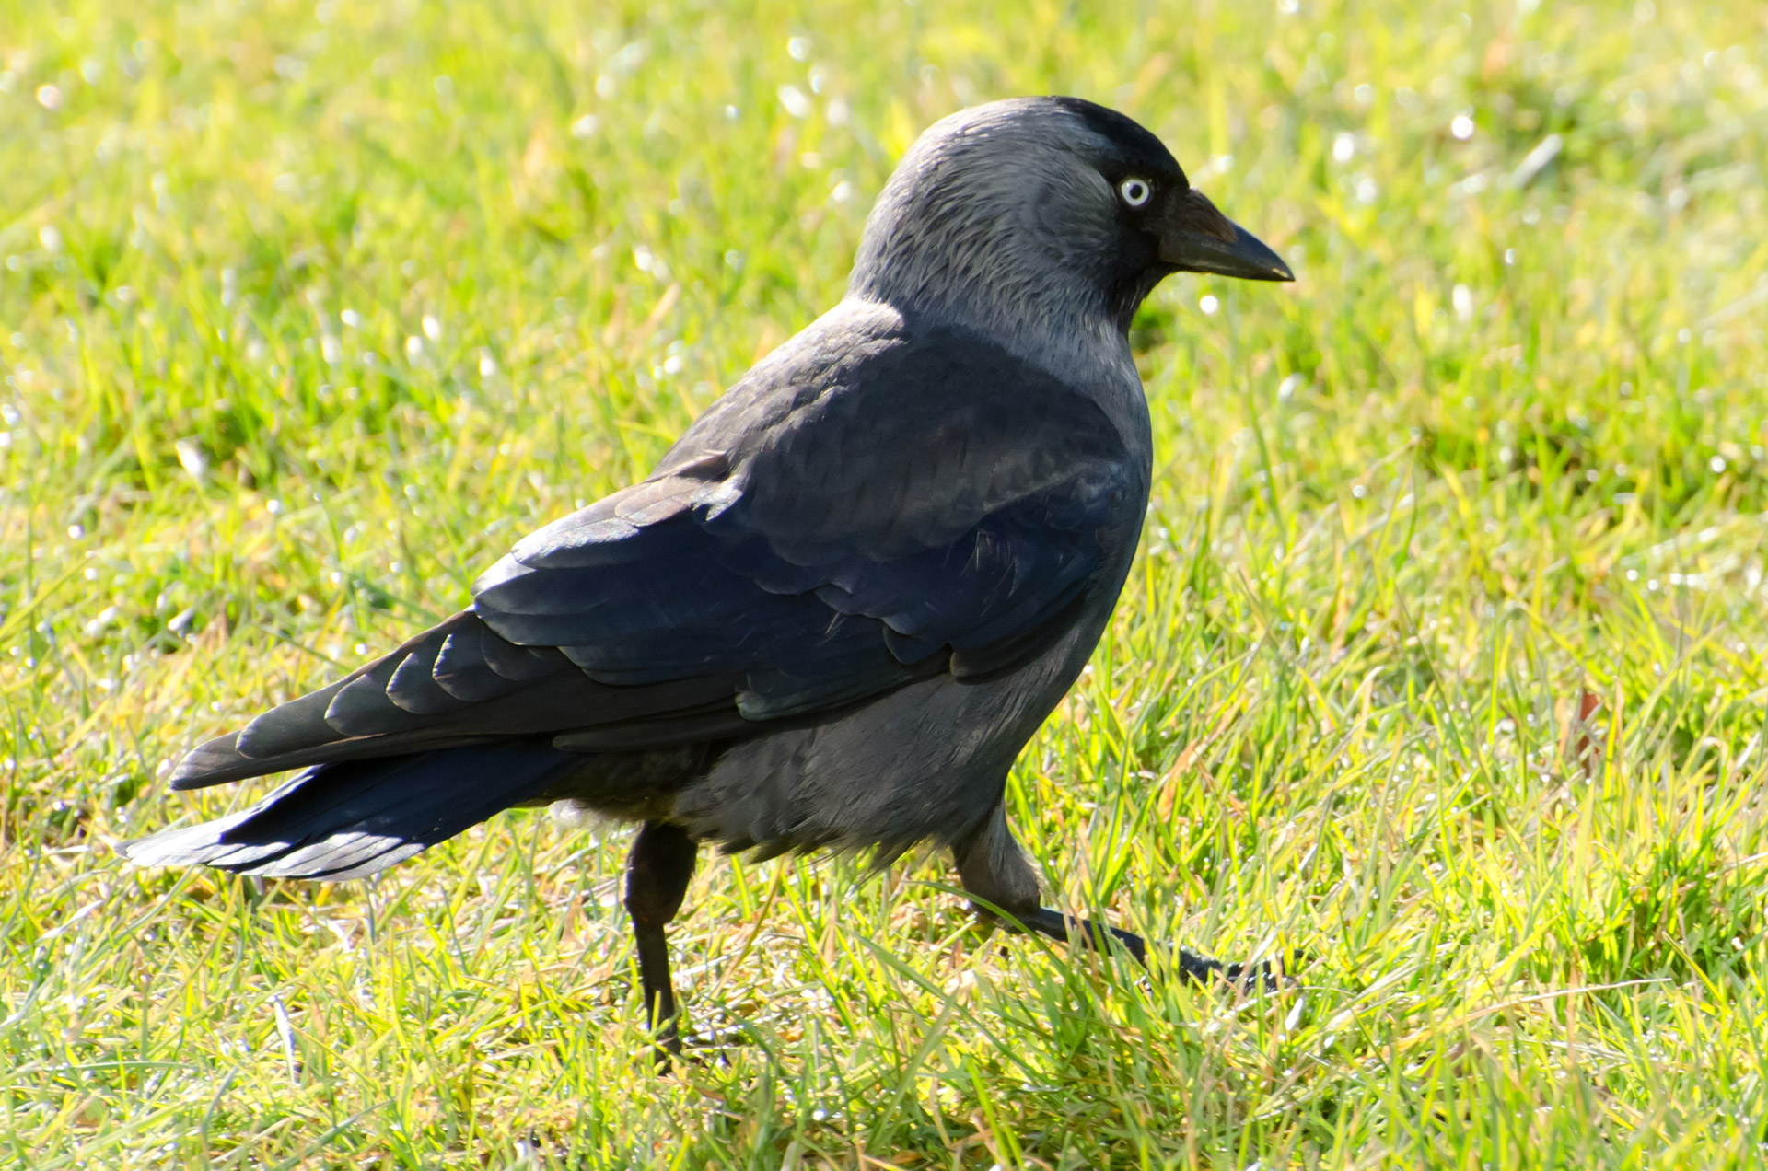
Hmsc package in R
Simulated Data
Linear model
Presence absence model
Abundance model
Real World Example with Finnish birds
Corvus monedula, Western Jackdaw

Slide 10
Joint Species Distribution Models (JSDMs)
Full functionality of JSDMs:
Multiple species
Environmental, trait, and phylogenetic predictors
Handle hierarchical and spatially structured data
Explicitly account for stochasticity through variance partitioning
Our introduction:
Single species
Environmental predictors only
Examples with hierarchical and spatially structured data

Slide 11
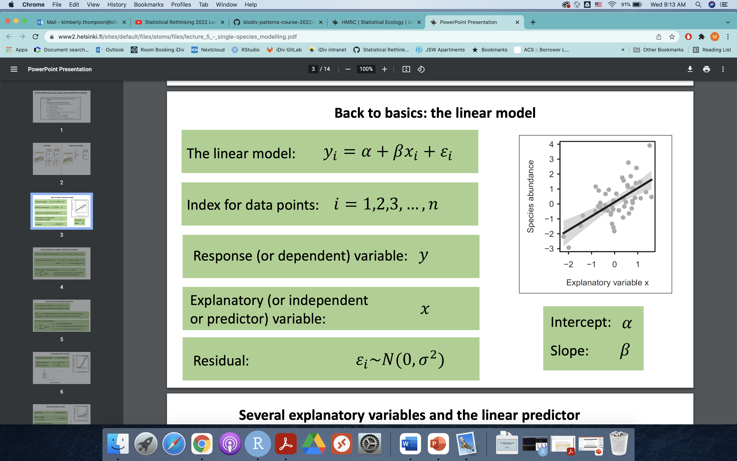

Slide 12
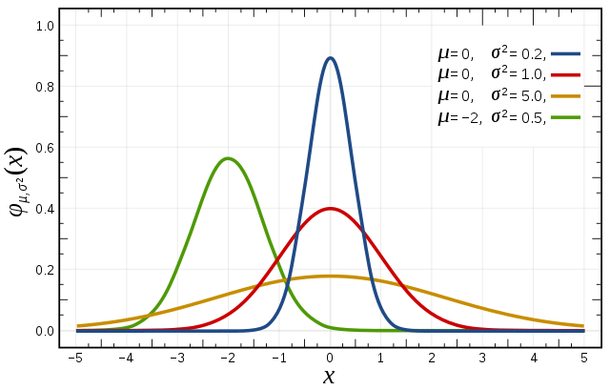
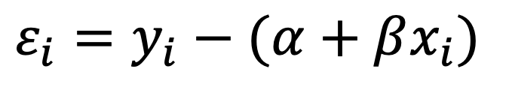
Back to basics: the linear model
$$ε_{i}=y_{i}−(α+βx_{i})$$

Slide 13
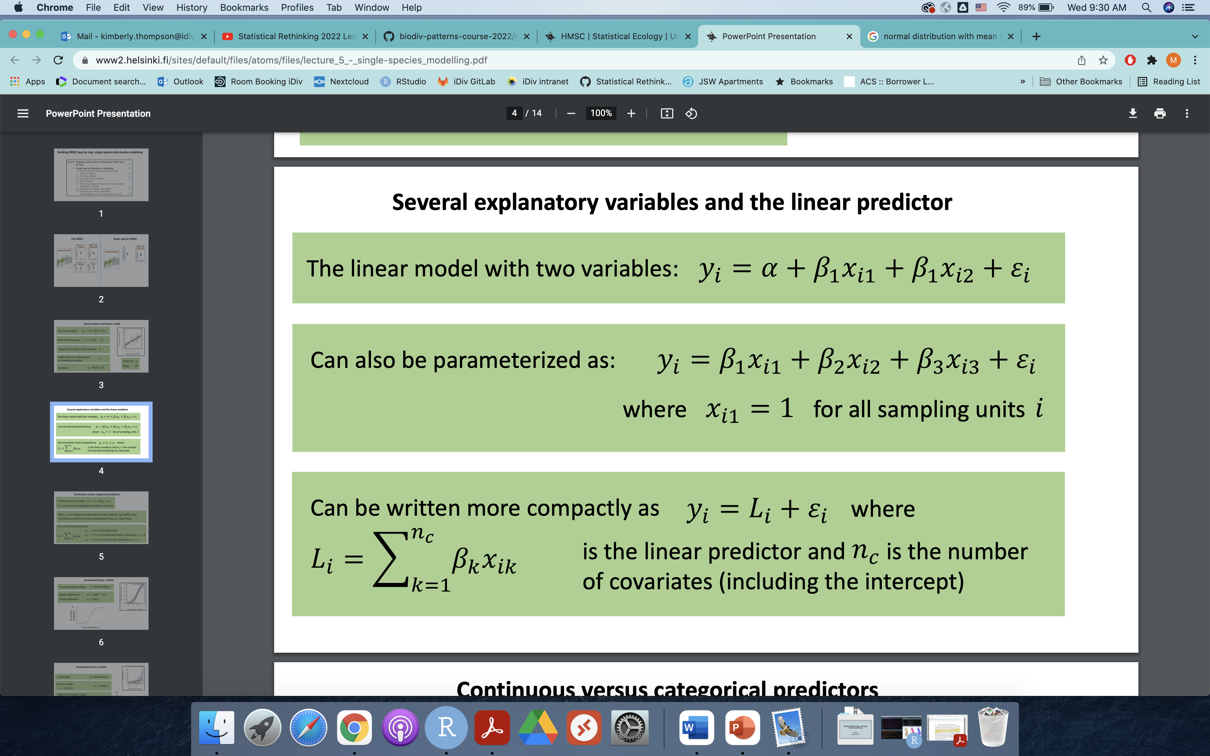
2

Slide 14
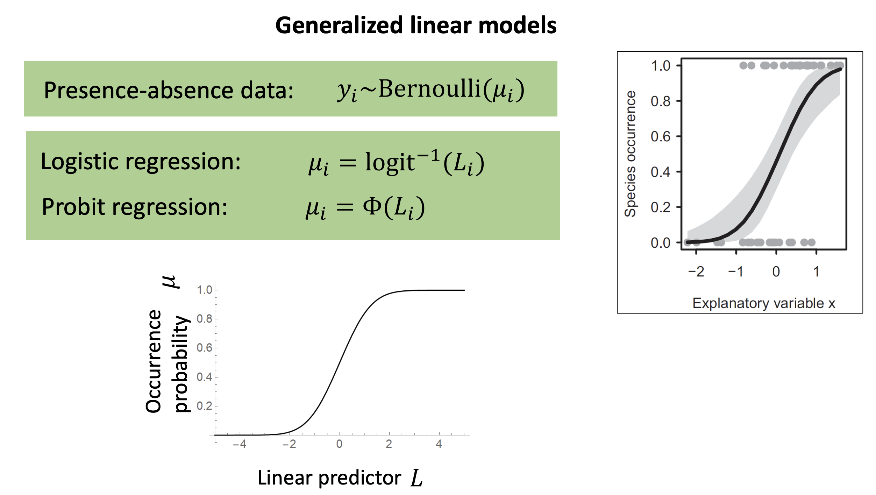

Slide 15
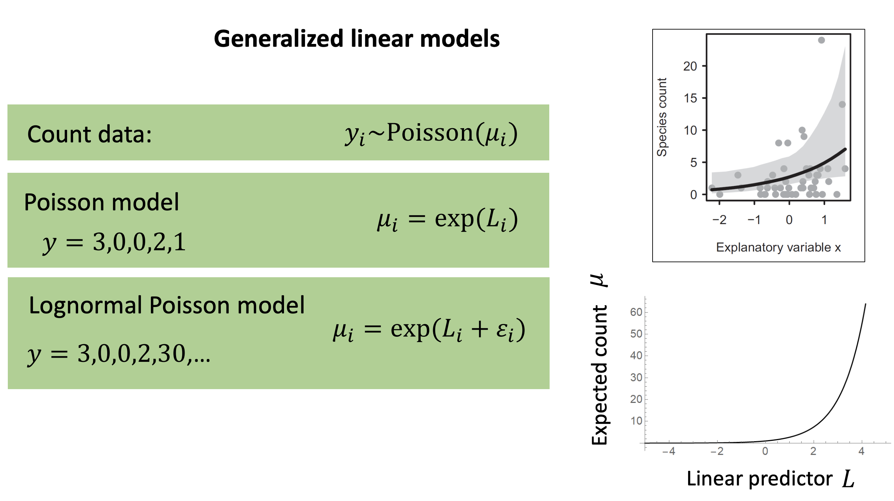

Slide 16
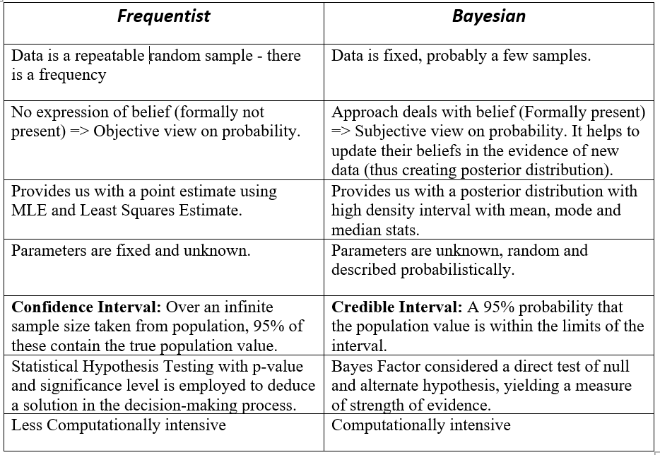

Slide 17
Let’s get started!

Slide 18
